Slide 1
Universidade Federal de Alagoas
Instituto de computação
Programa de Pós-Graduação em Informática - PPGI
Research design update: 02/12/2019
Master Student: Christiano Rossini Martins Costa
Advisor: Baldoino Fonseca dos Santos Neto

Slide 2
Objective
Assess code smell perception (or agreement) aided by a decision tree classifier
Specific objectives
To what extent an aided aproach of code smell detection influence in developer's agreement about certain code smell.
Find out if decision tree complexity play a role in developer's agreement about certain code smell
Complexity: number of leaves, tree depth
Find out if decision tree assistance influences the effort to detect a code smell.
Time required to detect a code smell

Slide 3
Study context
Code smell (CS) type selection
Types:
Class scoped:
God class (GC)
Middle Man (MM)
Class Data should be private (CDSBP)
Method scoped:
Long method (LM)
Long Parameter List (LPL)
Feature Envy (FE)
Selection criteria:
Previous works about code smell detection, from CS with worst agreement (or perception) to CS with best agreement (or perception)
Smely code dataset
A manually validated code smell from Palomba et. Al

Slide 4
Study context
Independent variables (features)
Software metrics
Class metrics
Method metrics
Metrics categories (source code scope)
Complexity
Size
Coupling
Cohesion
inheritance
Metrics source: Scitool's Understand

Slide 5
Study context
Participants
Academy
Industry
Survey
Custom Web-based Survey, built upon Django framework
Supervised learning
Decision tree (DT) Classifier
Python Sklearn API
C.A.R.T. implementation of DT
Spliting criterion:
Options
Information Gain (Entropy)
Gini Index
Selected: Gini Index (most effective)

Slide 6
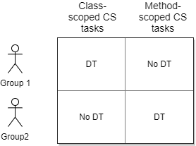
Study design
Latim square design

Slide 7
Study design
Latim square design
Blocking factors
Participants: Group 1 and 2
Random chosen participants to group 1 or group 2
Tasks
Scope | Code Smell type | Tree complexity
Class-scoped CS tasks | God Class Middle man Refused bequest | 3 to 9 leaves Tree depth
Method-scoped CS tasks | Long method Long parameter list Feature envy | 3 to 9 leaves Tree depth

Slide 8
Study design
Latim square design
Treatments
DT – source code analysis aided by a decision tree classifier
No DT – source code analysis NOT aided by a decision tree classifier

Slide 9
Study design
Research questions
RQ1: To what extent an aided aproach of code smell detection - using a tree classifier - influences in developer's agreement about certain code smell?
RQ2: How much effort do developer spend during code smell detection with a tree classifier assistance?

Slide 10
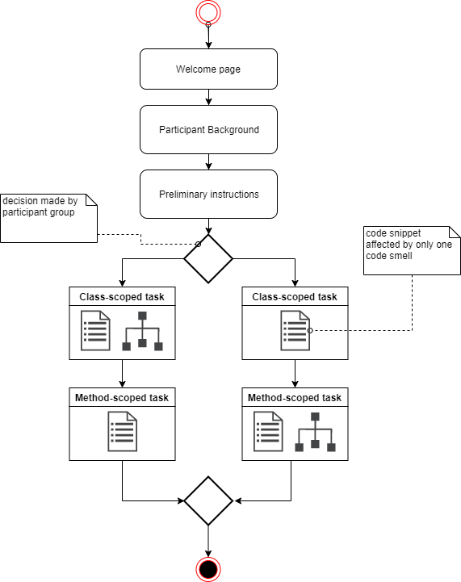
Study procedure
web survey flow

Slide 11
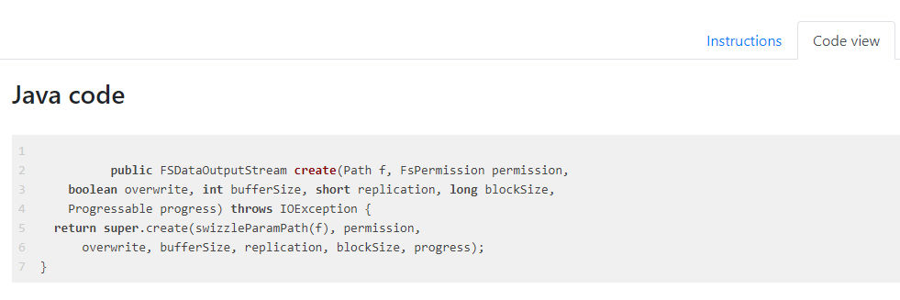
Study procedure
Code snippet view
Smely code affected by only one code smell

Slide 12
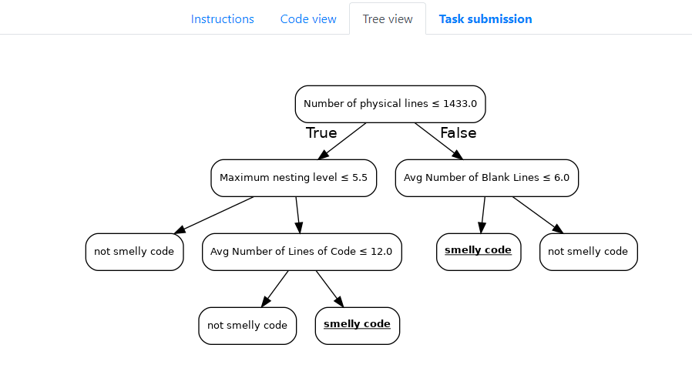
Study procedure
Tree view

Slide 13
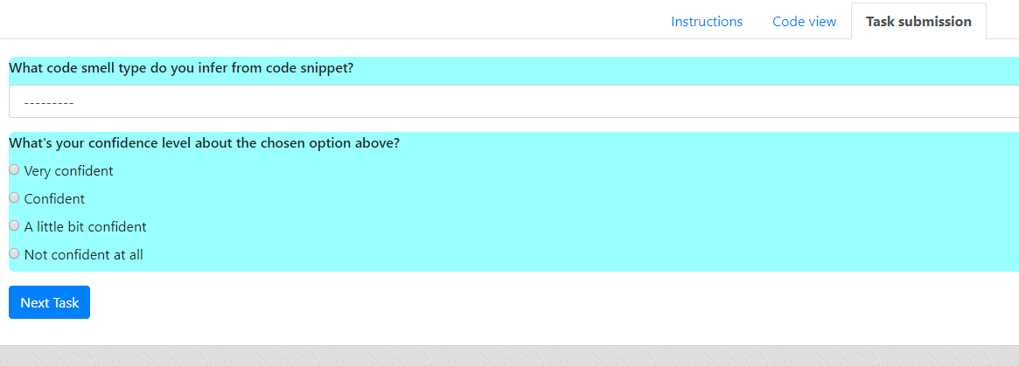
Study procedure
Task submission
Method or Class-scoped Code Smell Type

